Slide 1
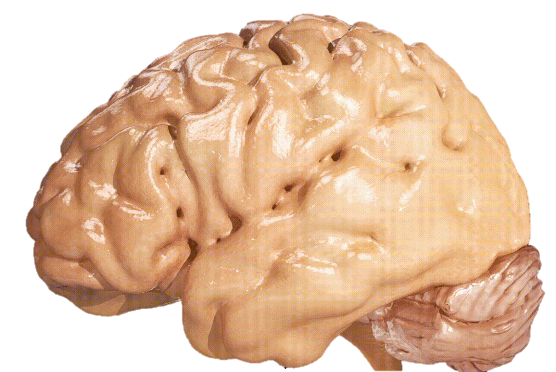
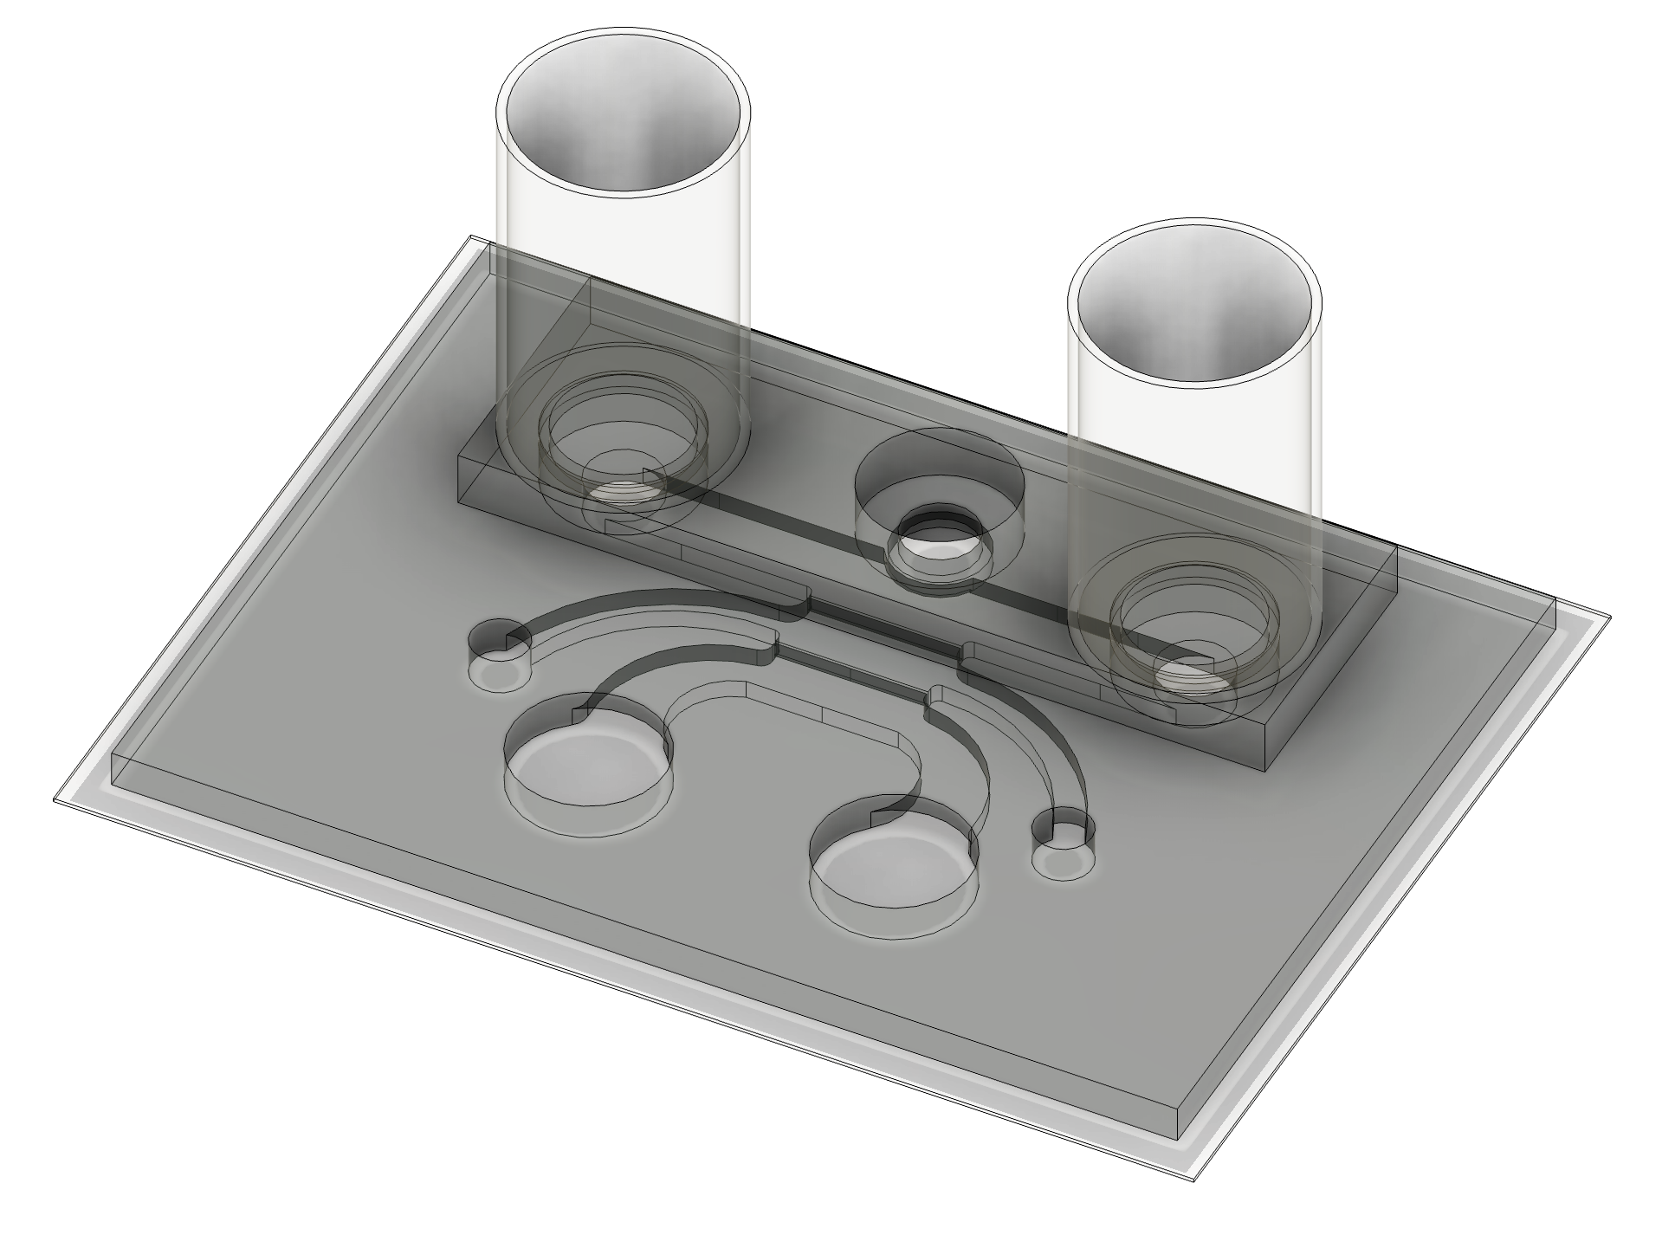
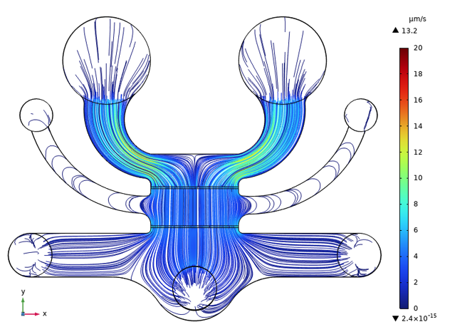
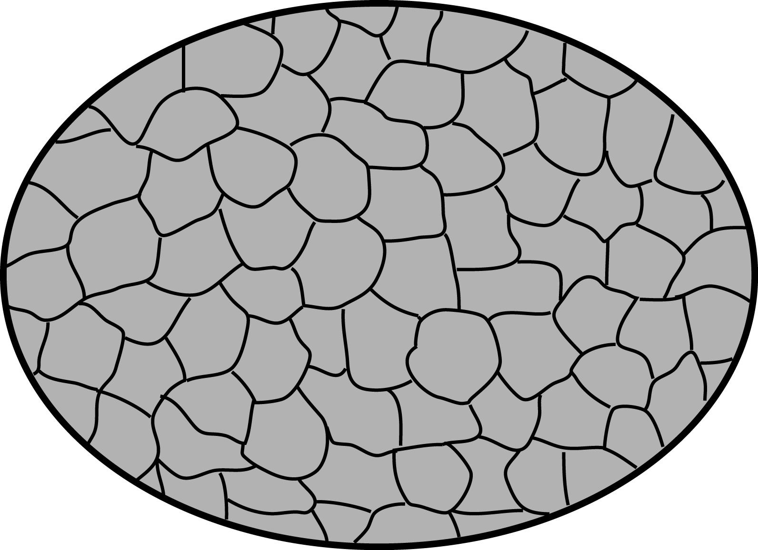
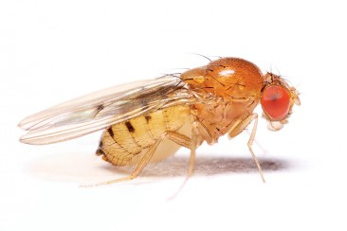
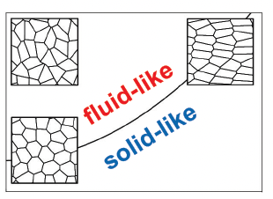
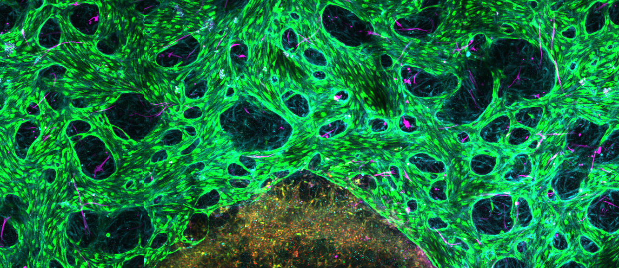

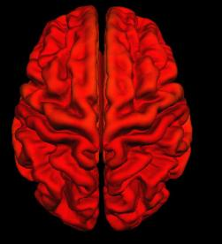
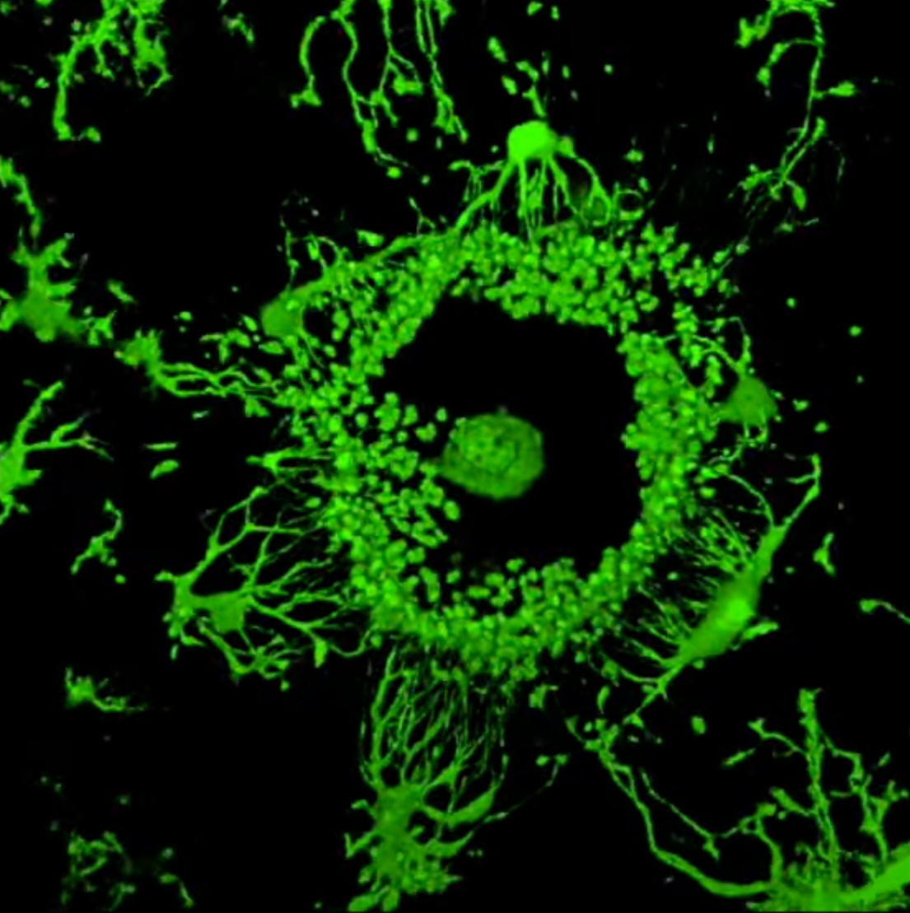
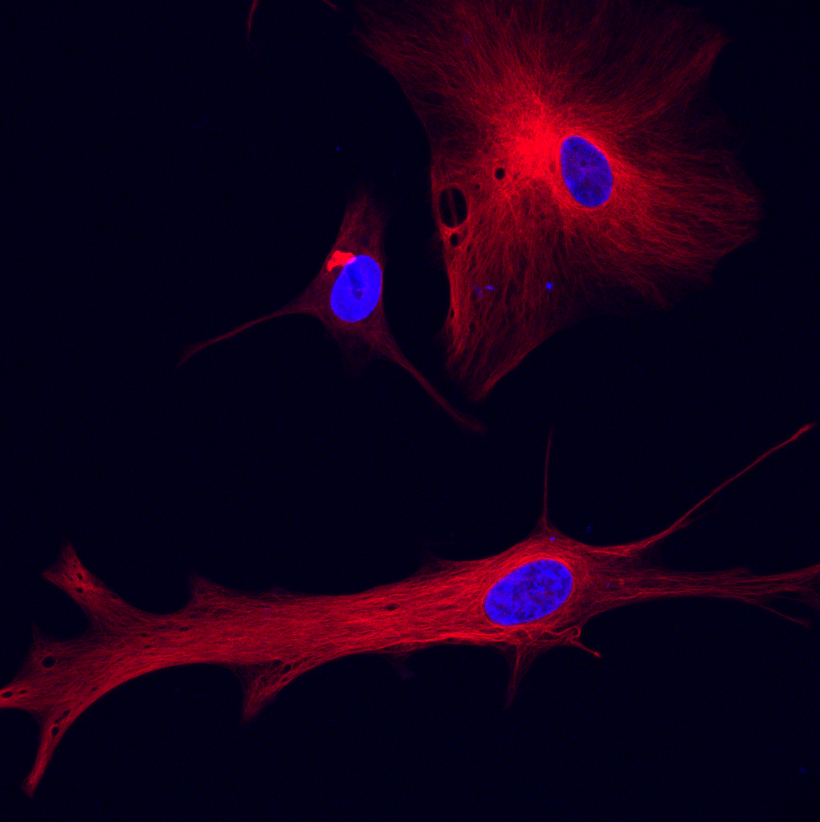
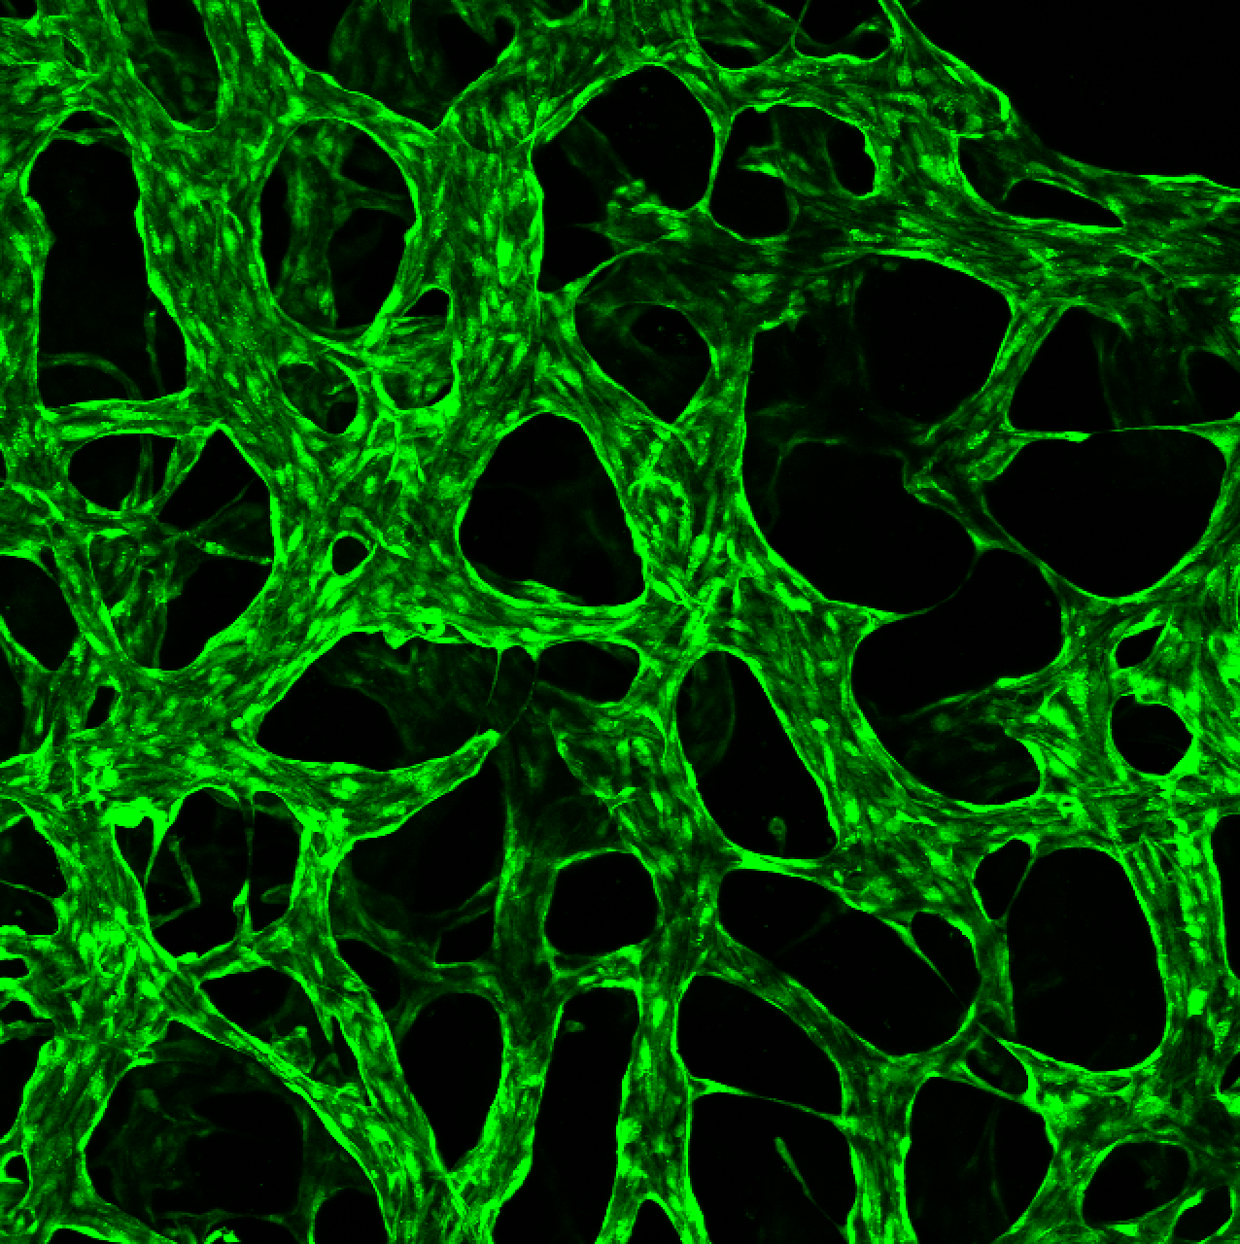
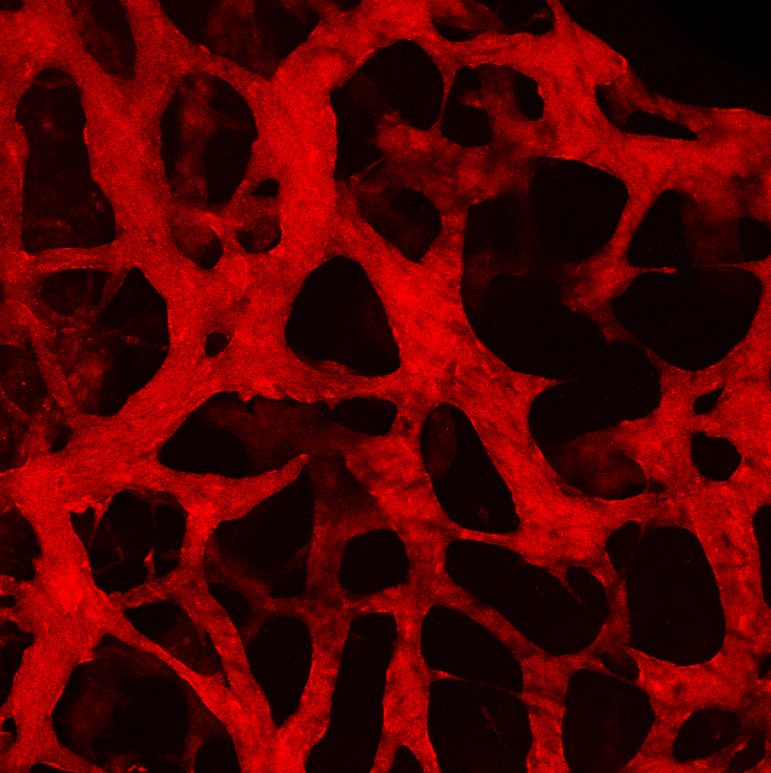
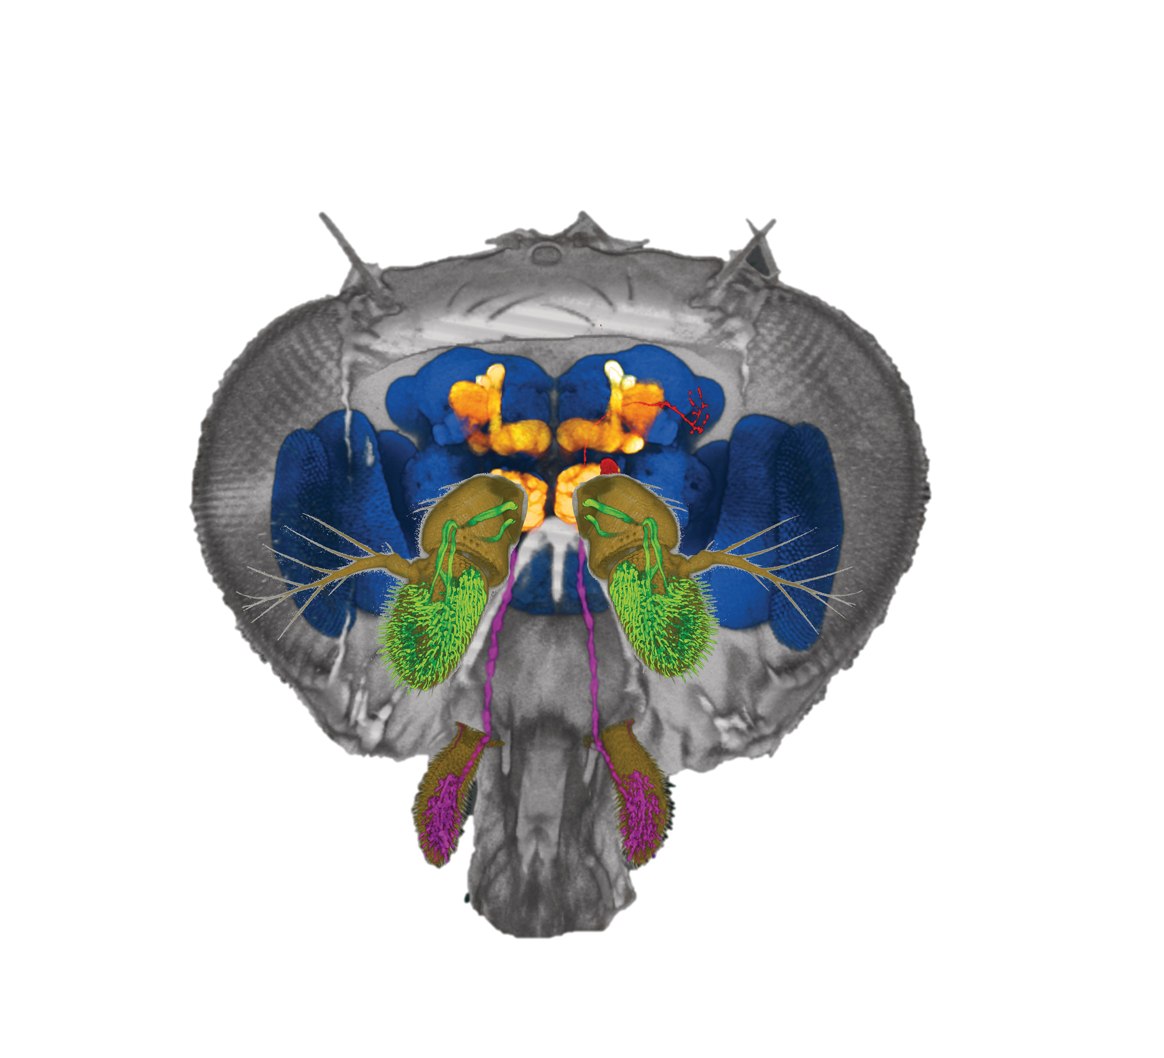
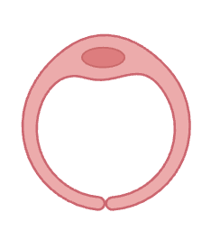
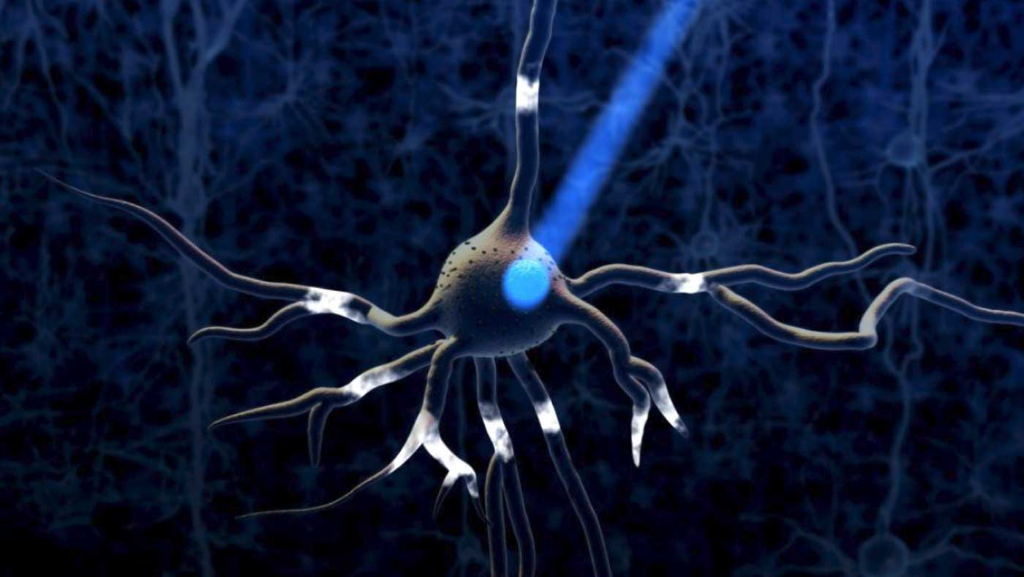
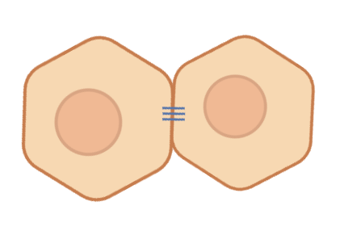
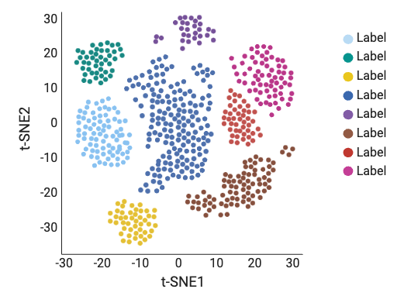
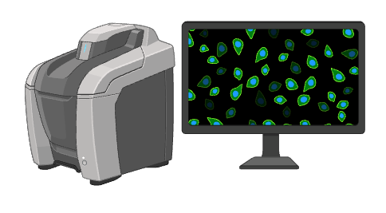
Overview figure
Mechanobiology
in-vitro disease models
(Postdoc @ MIT/MGH)
tissue
Biomechanics for Brain Health
tissue
Biomechanics
in-vivo systems
(PhD @ Columbia)
degeneration
mechanical engineering
generation
biophysics
bioengineering
microfluidics
neuroscience
Interdisciplinary Lab Goals
computation
morphogenesis
biology
AI
I. brain model
II. biomechanics measurements
III. mechano-biomarker + therapeutics
tunes
model
Alzheimer's brain-on-a-chip
(neurovascular + lymphatic)
Fundamental
Translational
tissue fluidity
multi-physics platform to measure mechanics change in AD
women’s health model
molecules/drug screening in the brain
2-3
Years
tissue
cell
sub-cell
elucidate
tunes
biomechanical mechanisms
optogenetics
for treatment
mechanobiological assays
optical tweezers
in-vivo twin-systems
mechanomedicine
& therapeutics
cell-cell adhesion
5-10
Years
high-throughput + AI
entrepreneurship

Slide 2
Overview figure
Mechanobiology
in-vitro disease models
(Postdoc @ MIT/MGH)
tissue
Mechanics for Brain Health
tissue
Biomechanics
in-vivo systems
(PhD @ Columbia)
degeneration
mechanical engineering
generation
biophysics
bioengineering
neuroscience
Interdisciplinary Lab Aims
computation
morphogenesis
microfluidics/FEA
biology
AI
model
tunes
Fundamental
Translational
tissue fluidity
Alzheimer’s brain-on-a-chip (neurovascular + lymphatic)
multi-physics platform to measure mechanics change in AD
women’s health
molecules/drug screening in the brain
elucidate
tissue
cell
sub-cell
mechanobiological mechanisms
tunes
optogenetics
for treatment
mechanomedicine
& therapeutics
assays
optical tweezers
in-vivo twin-systems
cellular mechanics
high-throughput + AI
entrepreneurship

Slide 3
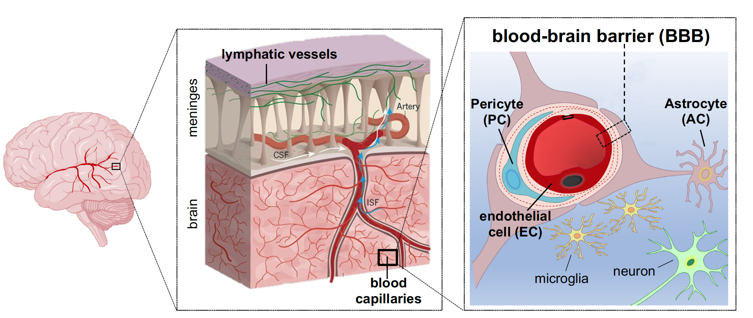
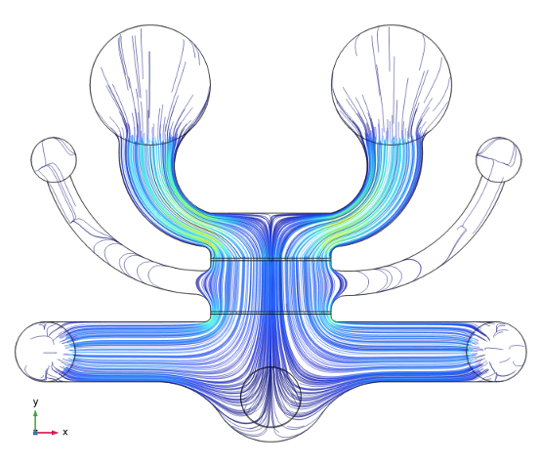
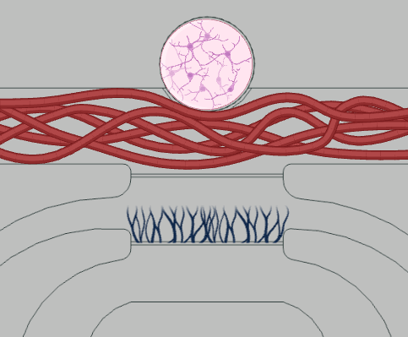
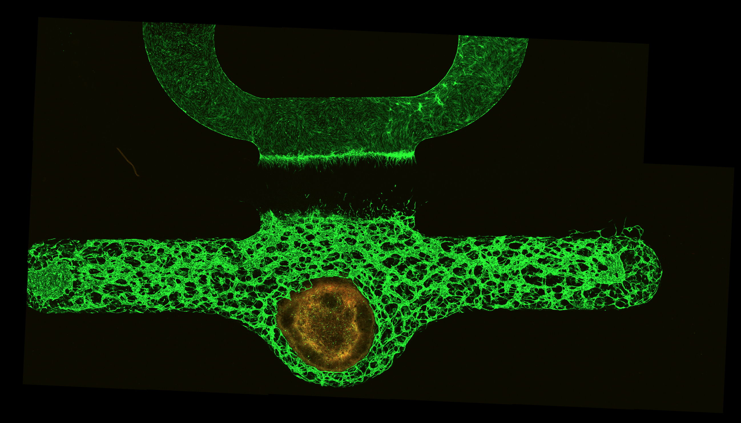
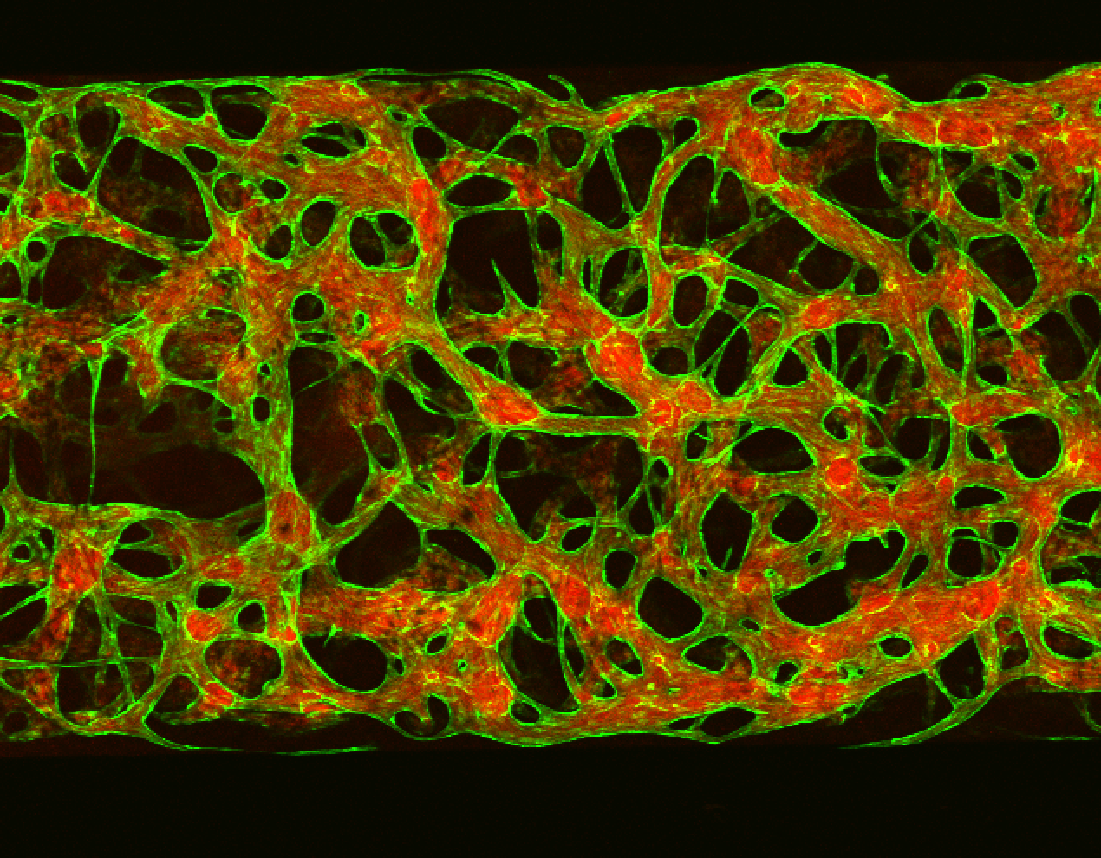
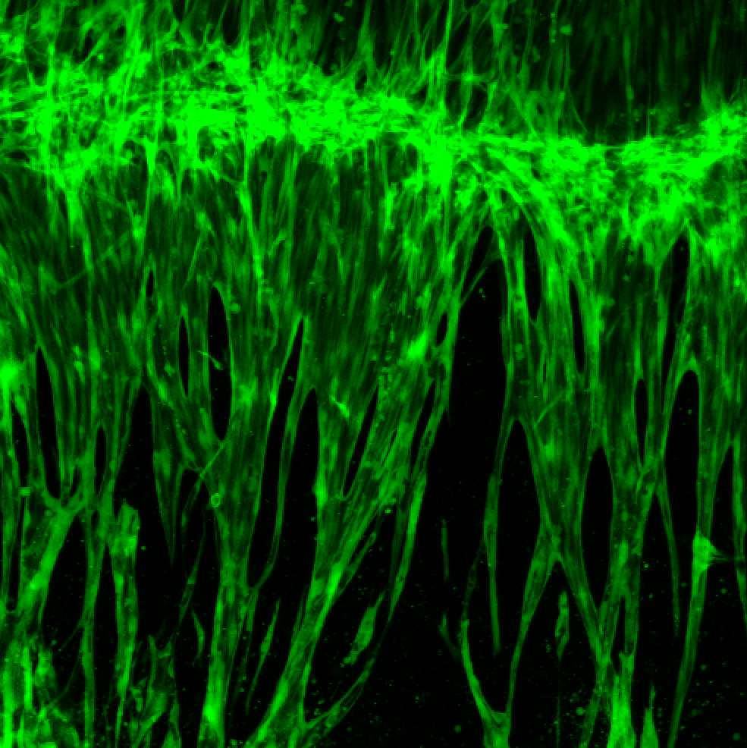
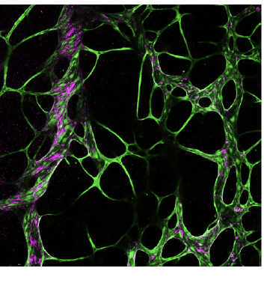
Background figure
a
b
AD/WT neuron culture channel
blood vessel culture channel
lymphatics culture channel
2 mm
c
d
e
f
1 mm
WT/AD
neurons
BBB
meningeal lymphatics
500 μm
200 μm
250 μm
Notes:
Error bars: b: 2 mm c: 1 mm d: 500 um e: 200 um f: 250 um

Slide 4
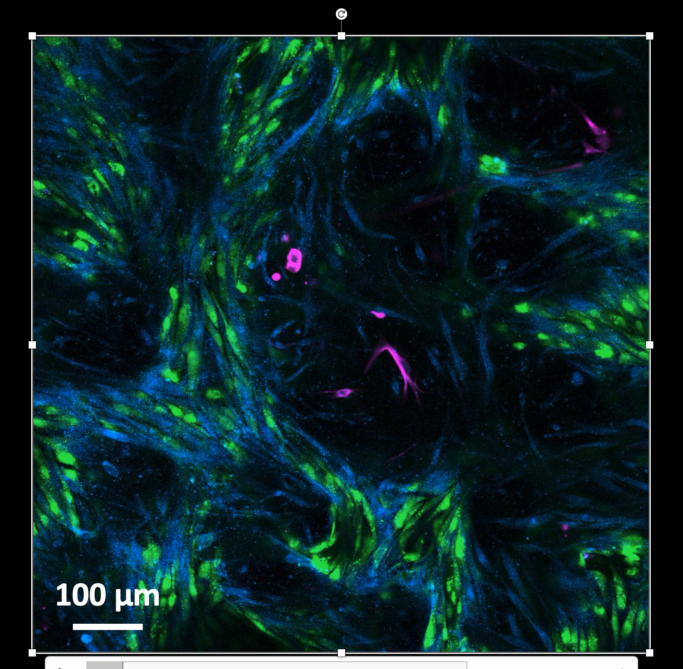
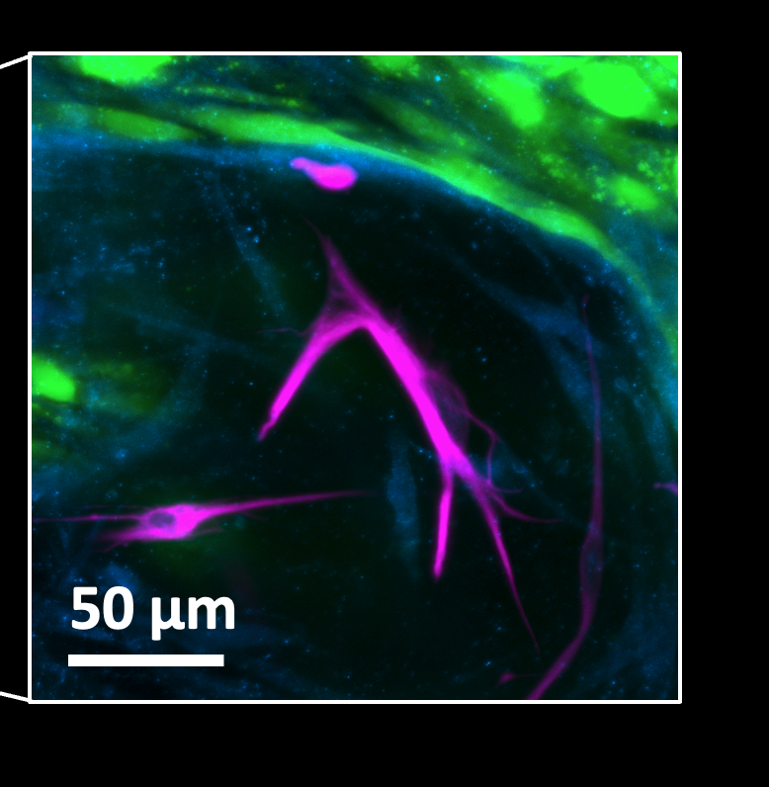
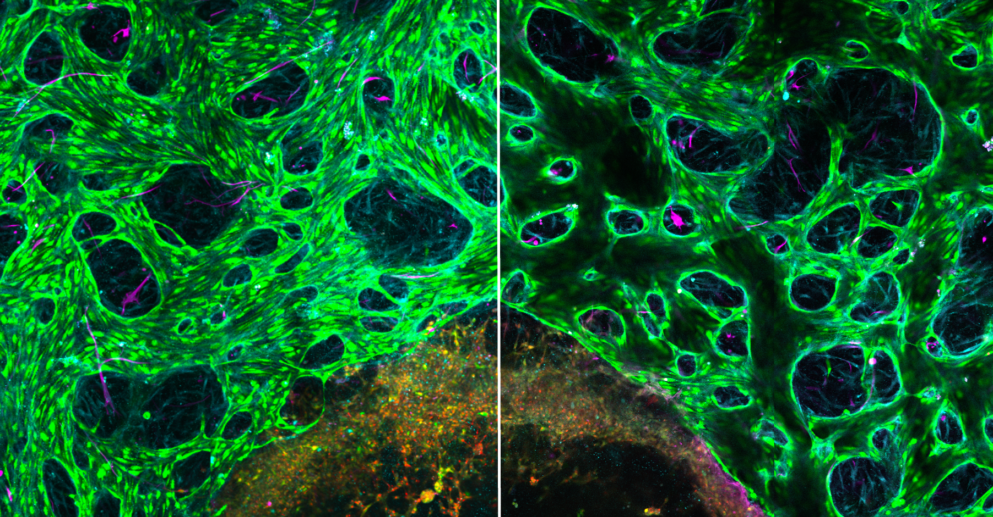
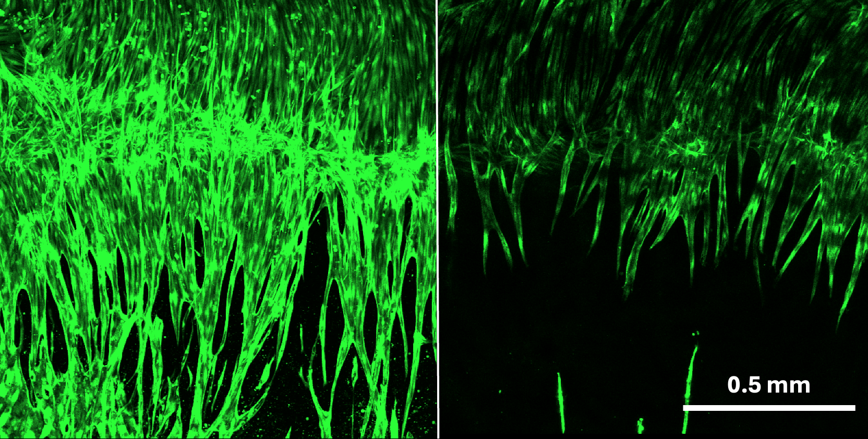
g
h
i
WT
AD
perfusable blood-brain barrier
WT/AD neurons
endothelial cell pericyte astrocyte neurons
sprouting meningeal lymphatics
Notes:
Error bars: g 300 um

Slide 5
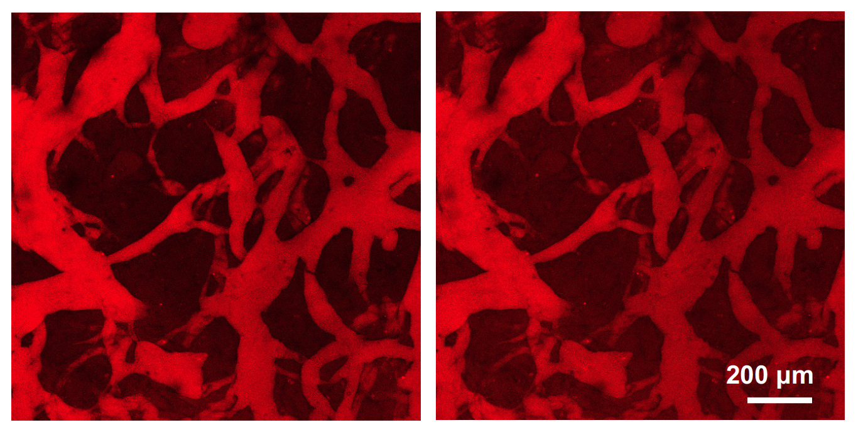
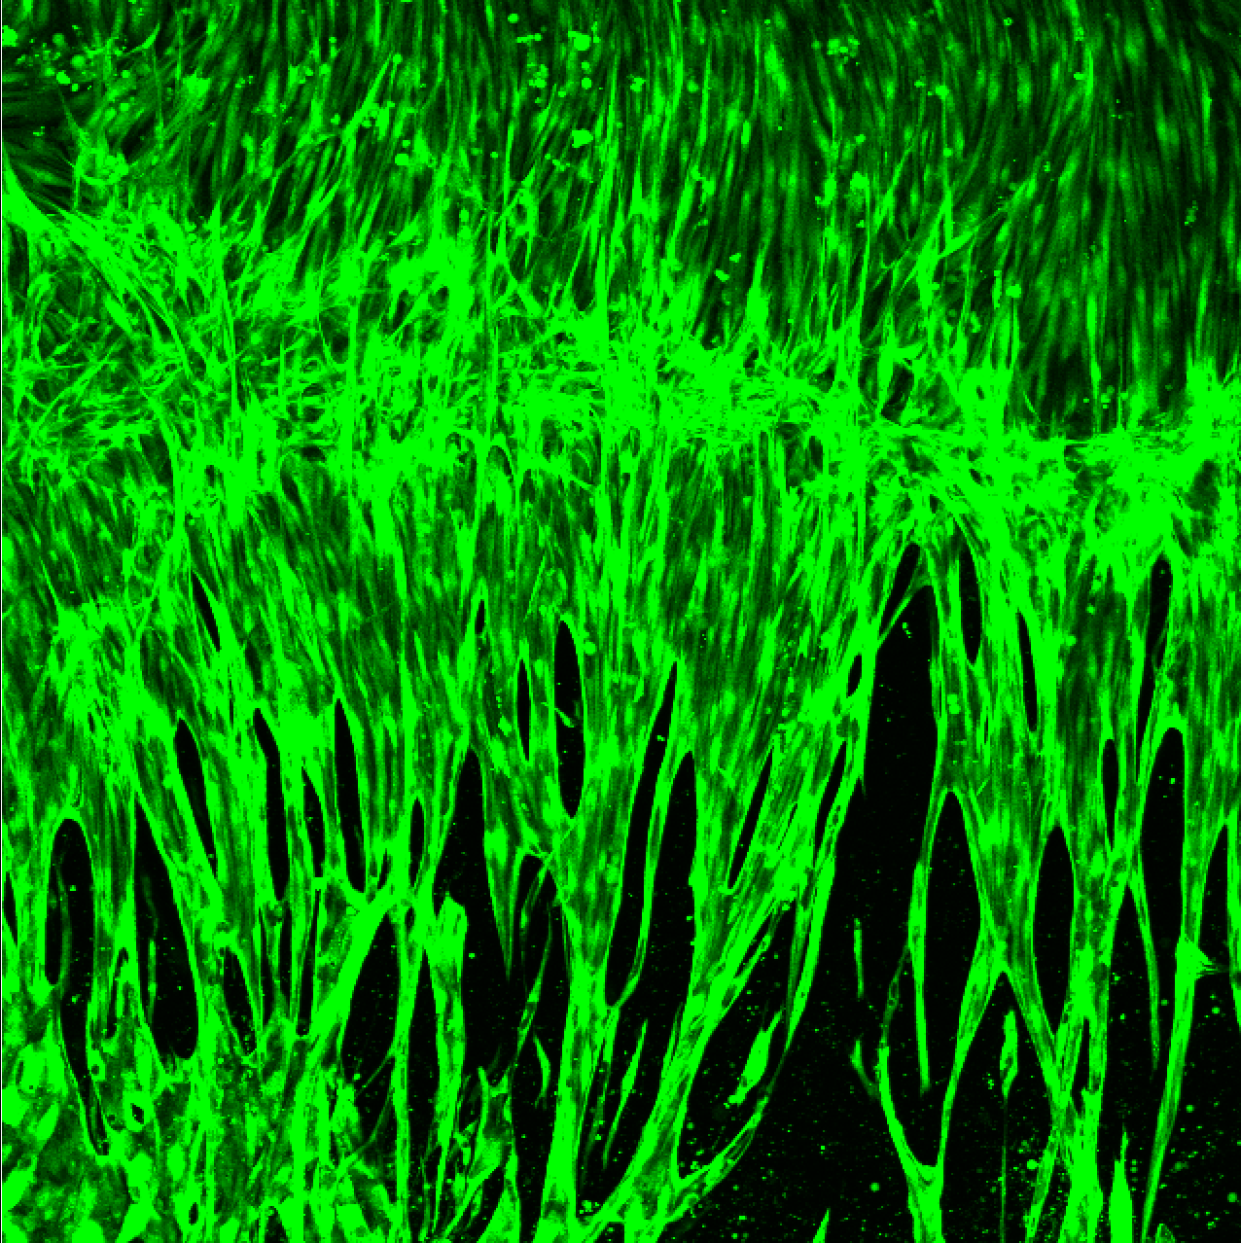
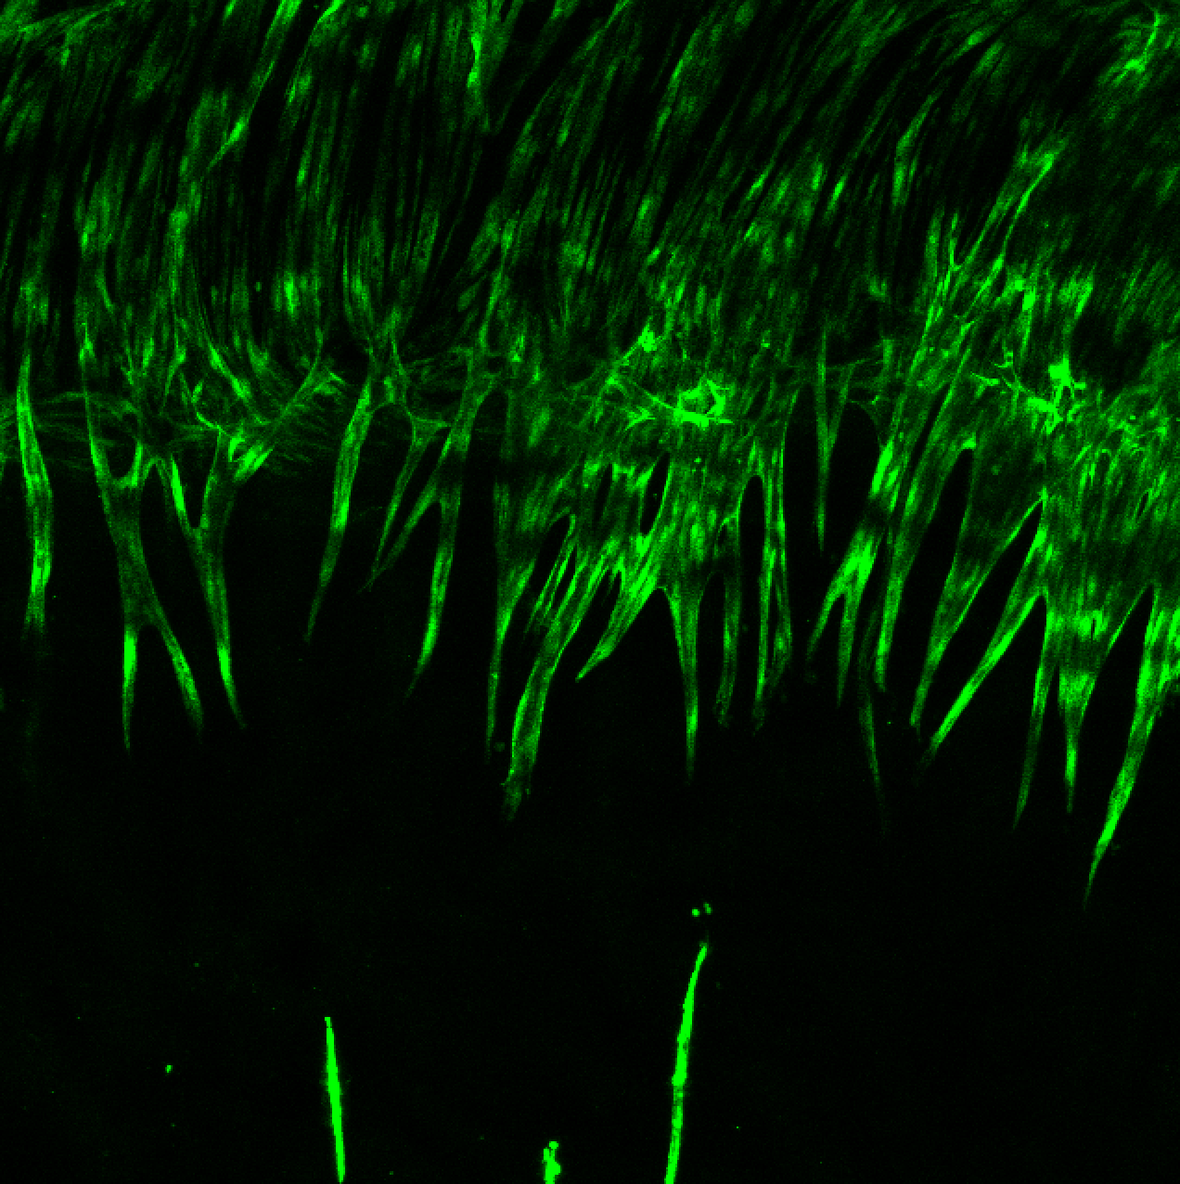
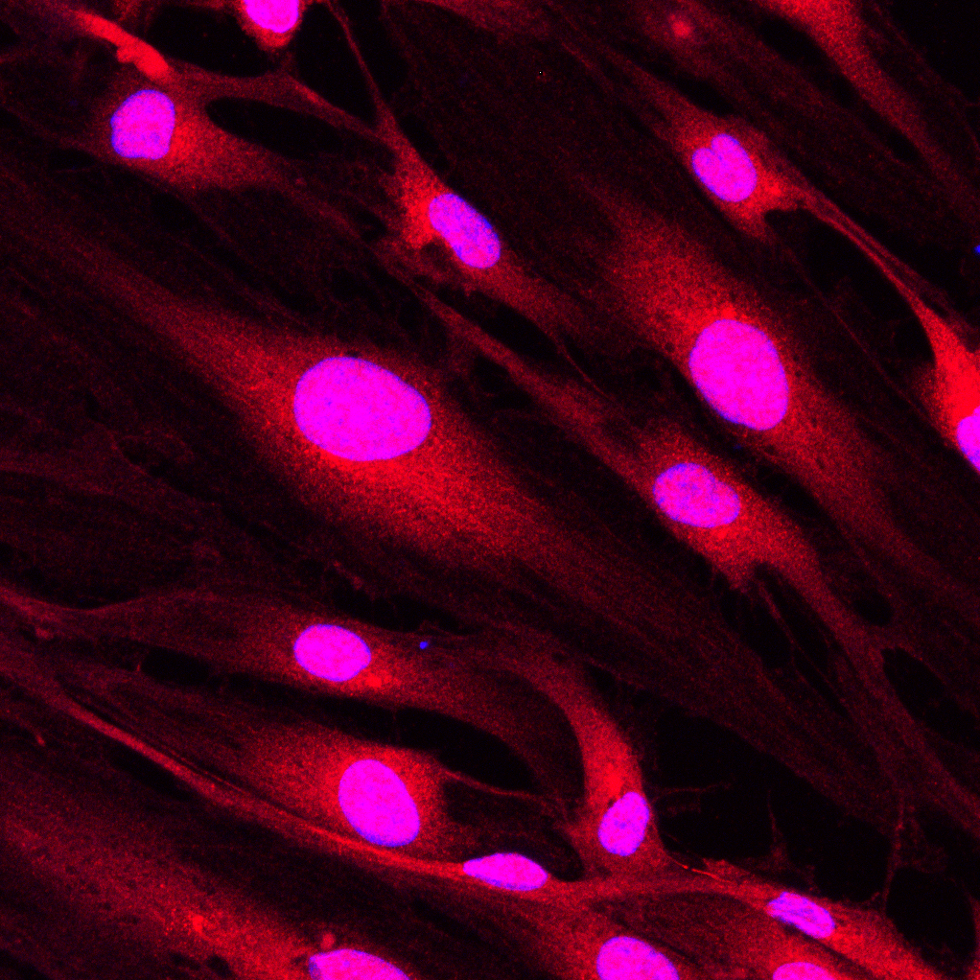
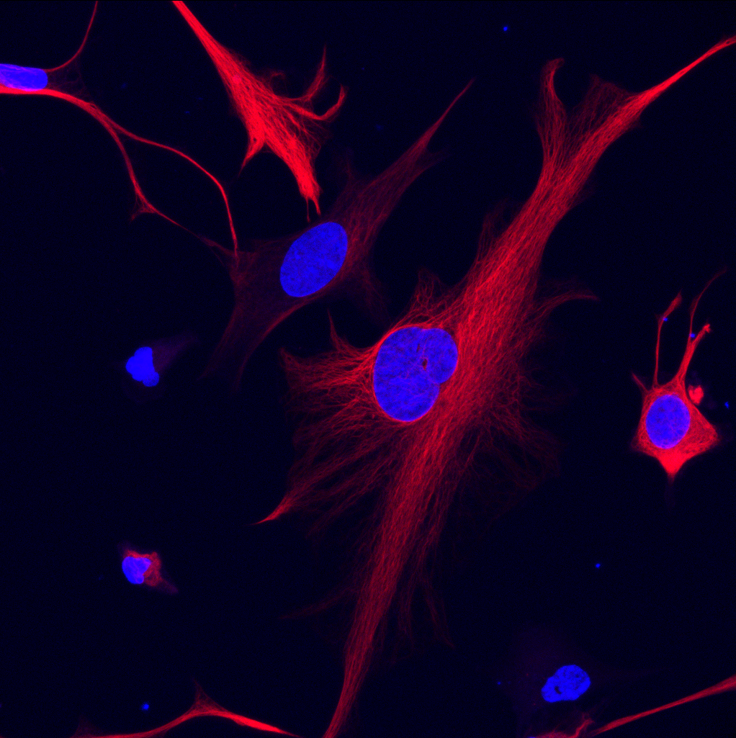
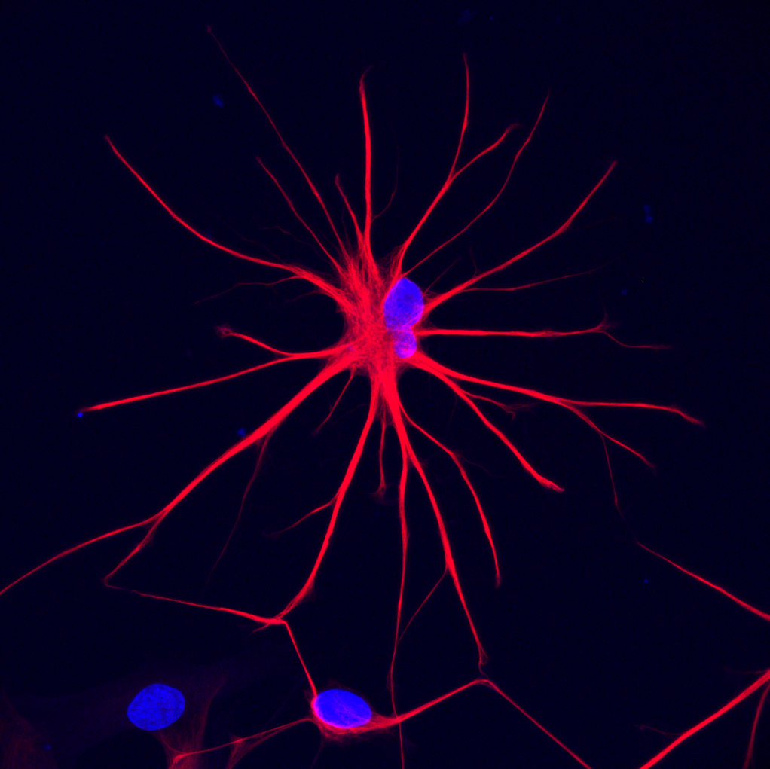
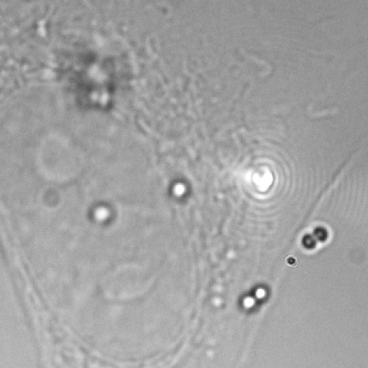
Preliminary result figure
a
b
c
500 μm
d
f
DAPI Piezo1
50 μm
Notes:
A: 200 um b 500 um d 50 um

Slide 6
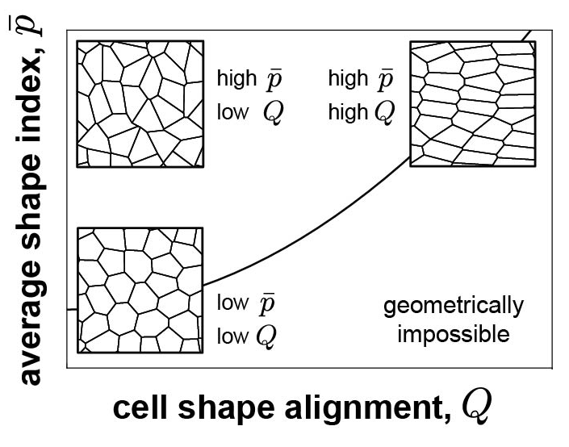
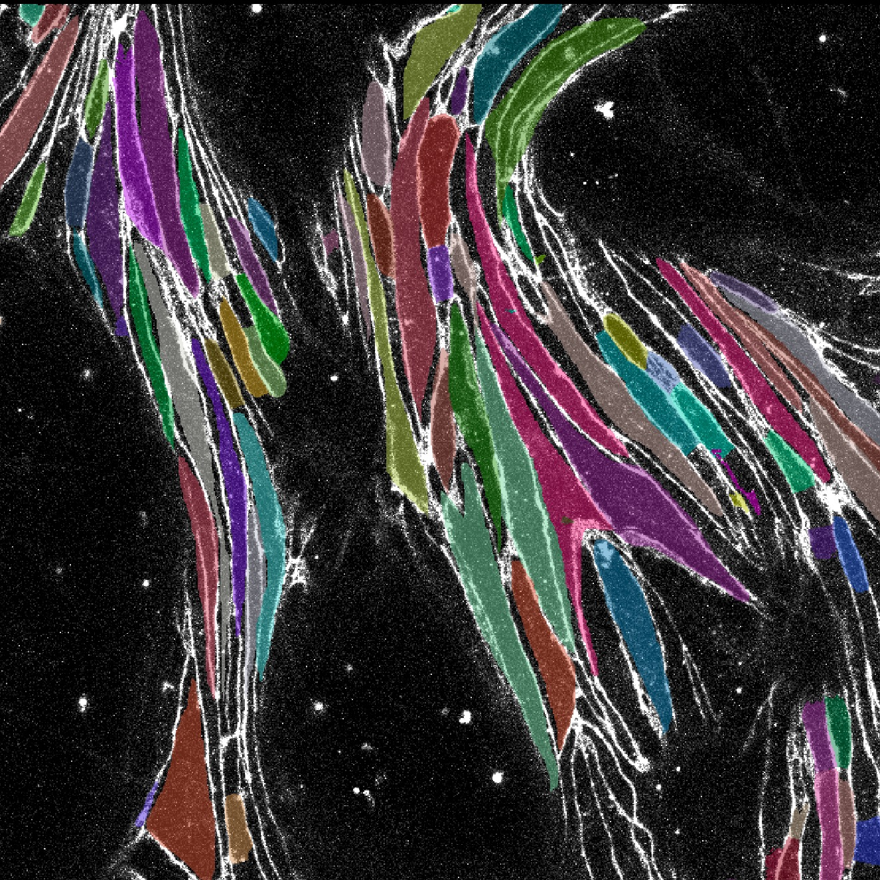
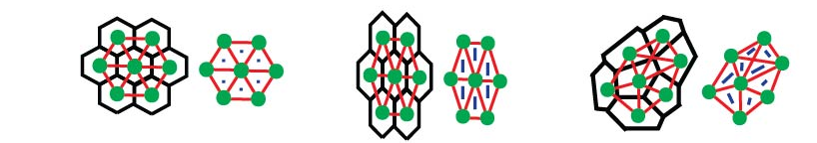
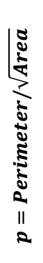
Preliminary result figure
g
h
i
j
Storage Modulus G’
(elastic)
Loss Modulus G”
(viscous)
$$p=Perimeter/\sqrt{Area}$$
fluid-like
solid-like

Slide 7
The disruption of meningeal lymphatic sprouting in AD (BBB+NC+ML)
Seed Lymphatics on D5
Seed Lymphatics on D17
0.5 mm

